Slide 1
Capstone Project - Grouping Neighborhoods by Proximity and Content

Slide 2
The Problem
You have a successful business in one part of the city.
You need to expand to a new area of the city, but don’t know where or how similar other parts of the city are to yours

Slide 3
The Data Solution
Use data from Foursquare’s Venues API to identify clusters of venues throughout the city and then classify them based on the content of their categories
Also can scale these venues by the # of likes they have to get a feel for traffic/volume

Slide 4
Methodology
Analyze different endpoints within Venues API.
Used
Explore
Likes
Categories
Analyzed, not used
Search
Zip/postal codes may not be available &/or may artificially segment groups of venues.
Used clustering to identify “neighborhoods”
Then cluster venue categories & subcategories in each neighborhood
Also looked at clustering venues themselves based on their categories
Explored supplementing with Twitter API info, decided the value-add wasn’t worth the extra effort & complexity

Slide 5
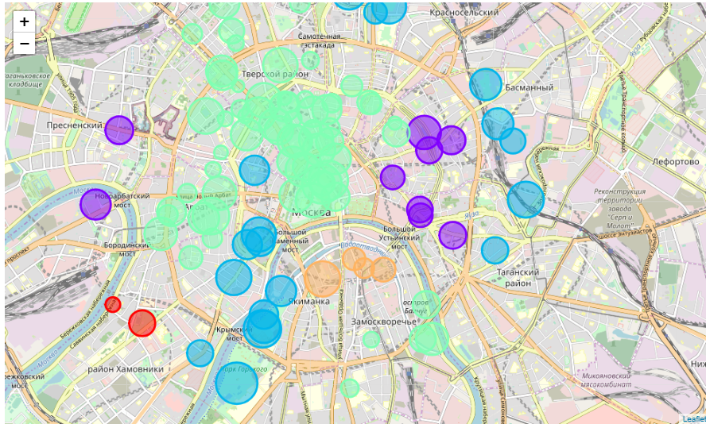
Results
There are several neighborhoods in the green sector at the top of the map, which have been clustered together by content
You can see some clusters in opposite areas of the city which are similar. If you have a successful business in one color of area, another branch in a similar colored neighborhood may be the right location!

Slide 6
End

